Slide 1
Introduction to MATLAB® Scripts and Functions
Sriram Krishnamurthy

Slide 2
Commands entered in the Command Window cannot be saved and executed again for several times.
Therefore, a different way of executing these commands is to create a file with these commands and then run this file every time we need to run the same operation.
There are two different ways to do this :
M-file Scripts
M-file Functions

Slide 3
M-file scripts
A script file is an external file that contains a sequence of MATLAB statements. Script files have a filename extension .m and are often called M-files.
M-files scripts simply execute a series of MATLAB statements.

Slide 4
Script Examples
mySphere.m
mySin2d.m
mySin2d_loop.m
compund_script.m
compund_script_loop.m

Slide 5
M-file function
functions are programs (or routines) that accept input arguments and return output arguments.
Each M-file function (or function or M-file for short) has its own area of workspace, separated from the MATLAB base workspace.
have a filename extension .m

Slide 6
Function Examples
Factorial.m
Average.m

Slide 7
Scripts | Functions
Do not accept input arguments or return output arguments. | Can accept input arguments and return output arguments
Store variables in a workspace that is shared with other scripts | Store variables in a workspace internal to the function
Are useful for automating a series of commands | Are useful for extending the MATLAB language for your application

Slide 8
Engineering Applications

Slide 9
Solving algebraic expression
function_solve.m
specvol.m
mulEq.m

Slide 10
Solving ODEs
simple_ode_solver.m
simple_sim_solver.m

Slide 11
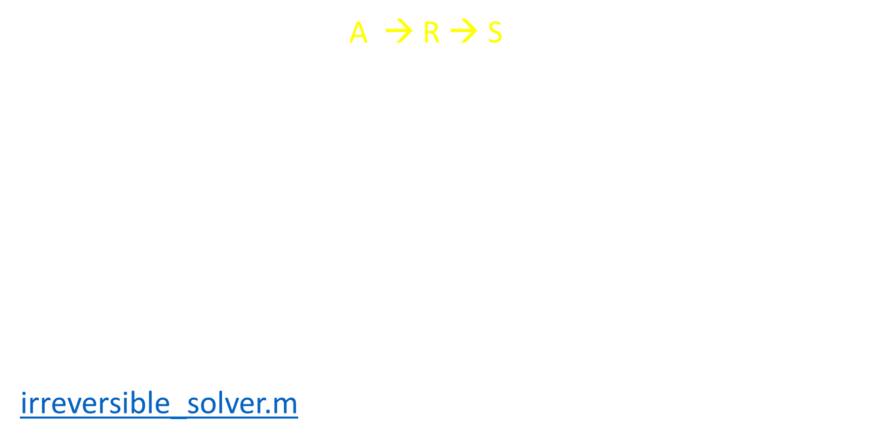
Irreversible reaction in series
A → R → S
$$r_{A}=\frac{dC_{A}}{dt}=−k_{1}C_{A}$$
$$r_{R}=\frac{dC_{R}}{dt}=k_{1}C_{A}−k_{2}C_{R}$$
$$r_{S}=\frac{dC_{S}}{dt}=k_{2}C_{R}$$
irreversible_solver.m

Slide 12
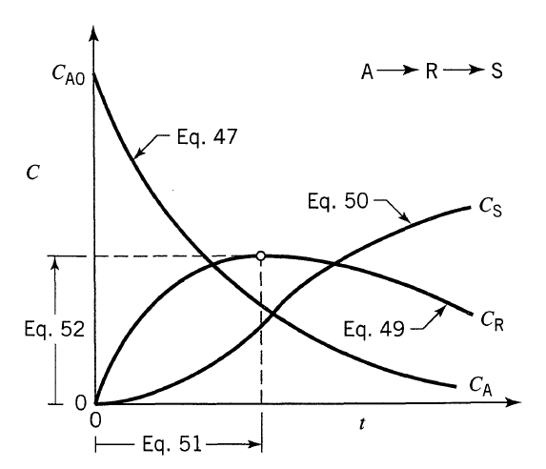
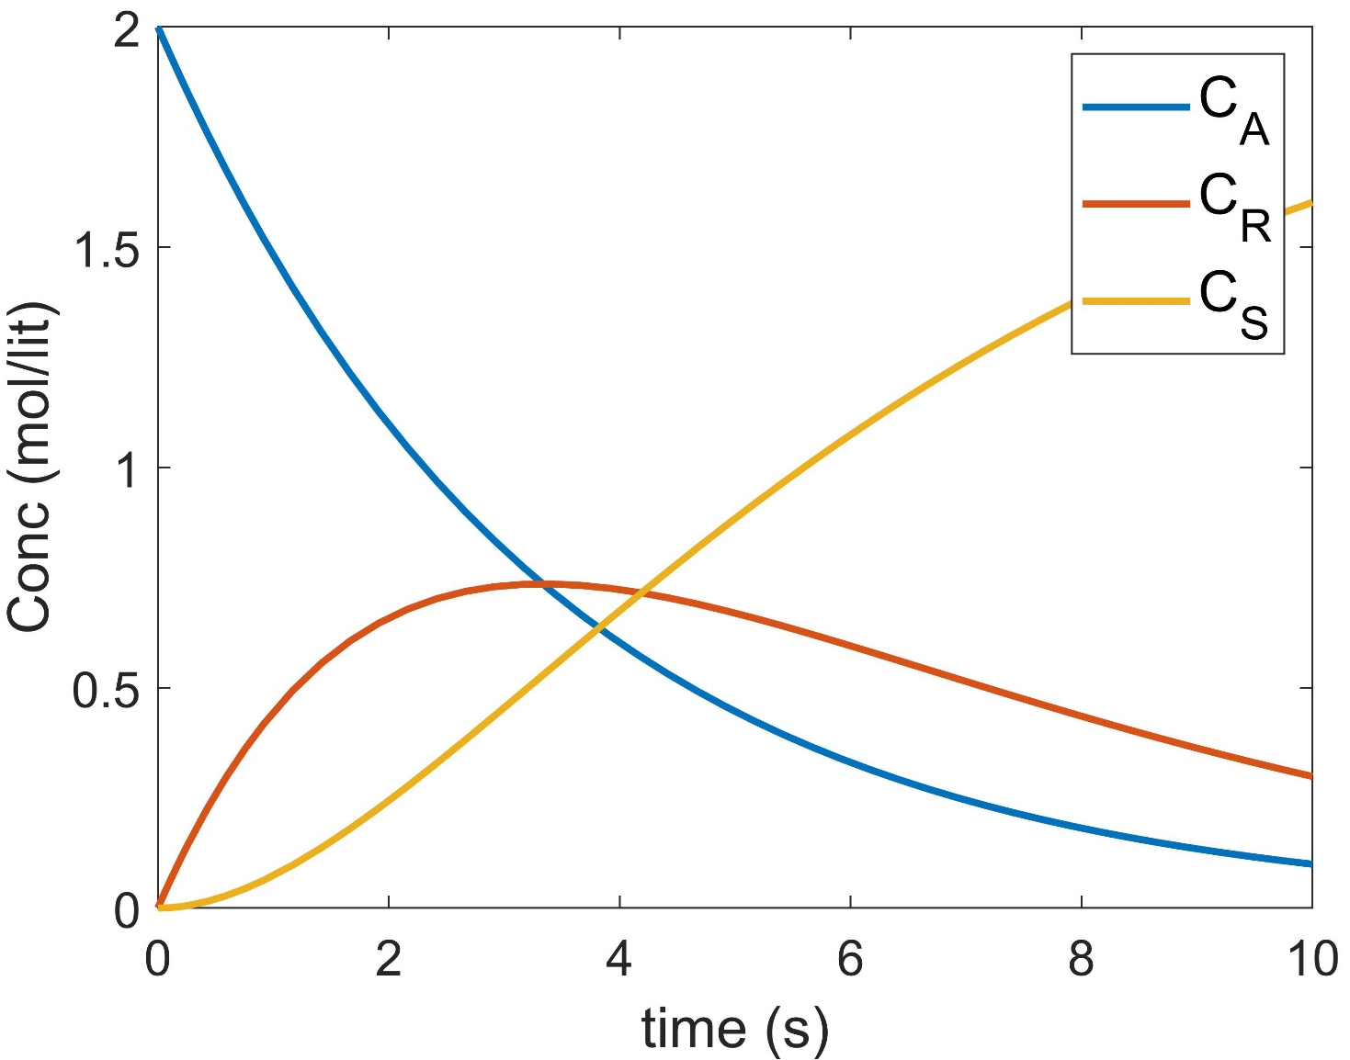

Slide 13
Numerical Integration
integ_example1.m
integ_example2.m

Slide 14
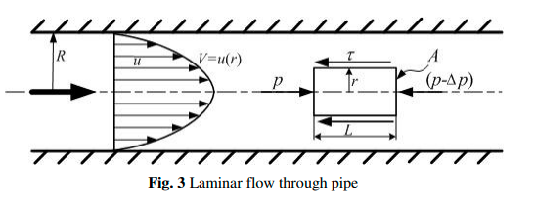



Average velocity of a fluid – Steady state laminar flow
$$V_{avg}=\frac{2}{R^{2}}\int_{0}^{R}{u\left(r\right)rdr}$$
Velocity Profile
Average velocity - analytical
Average velocity - integration
laminar.m

Slide 15
Curve Fitting
straight_line.m
exponential.m
GUI examples for curve fitting.
Readtable excel

Slide 16
THANK YOU

